Slide 1
ISO27001/ISO9001
(and/or other ISO standards)
Auditee guidance & preparation
for internal and external audit

Slide 2
(Hidden) User Guide - How to use this deck
Slides with the “no-presentation” icon in upper right corner are hidden
You’ll find some guidance, hints and tips at the end of the presentation
Presentation has no graphical layout, you can add company layout to it, as you wish

Slide 3
First time – Time needed - +/- 45’-60’
Keep it simple,
Simply explain what you normally do
Add reference to you daily job
  What is in your agenda.
    History of last month, last year, …
    Planning for Next month, next year

Slide 4
(Hidden) yearly update - Time needed - +/- 30’
Copy/paste last year version to new one
Update last year version with this year info

Slide 5
Data protection / security instruction
Avoid data leakage
Add links and references to documentation and events
  Click on links during presentation
Do not add sensitive information directly to slides
Only mention
  Document name
  Version
  Last review or publication date
  Owner

Slide 6

Our team (who are we)
Introduce yourself
Introduce team members in meeting
Team composition
  Manager
  Team Lead
  Members
  …

Slide 7
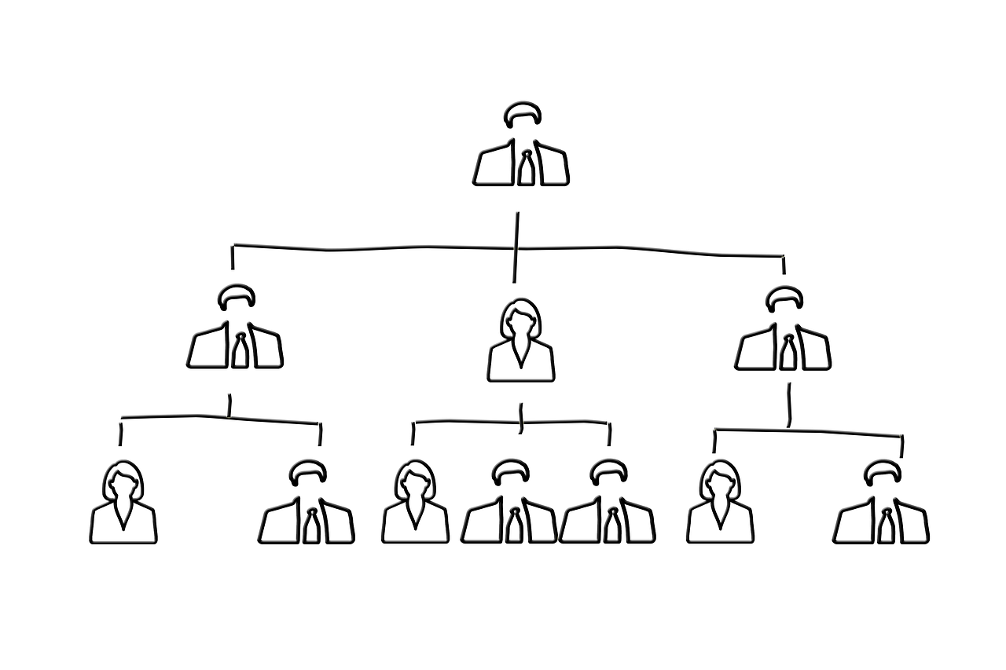
Our team (position in organigram)
Add organigram
Show position of team in relation to other departments and/or teams

Slide 8
Team responsibility, main tasks and processes
Roles & Responsibilities
Tasks
Processes in control (ref. process turtle)

Slide 9
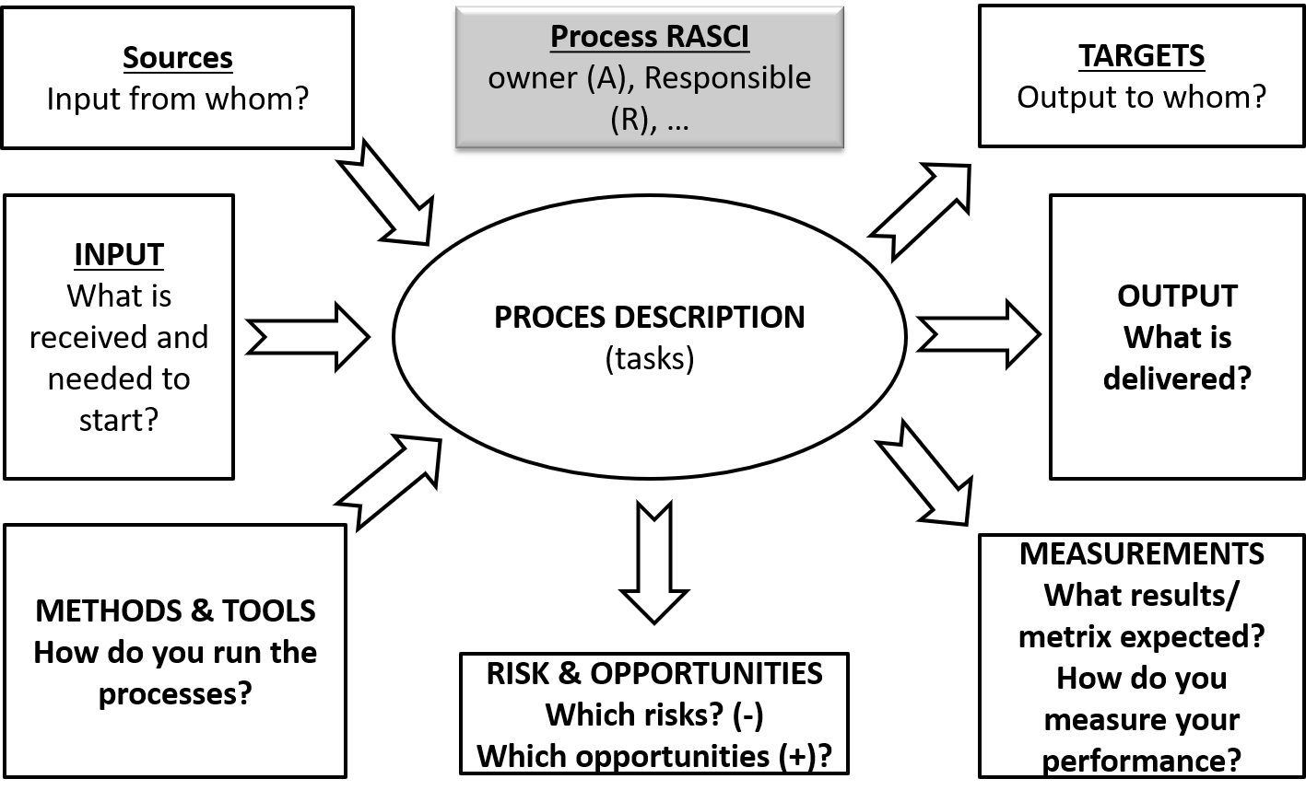
Process definition / turtle diagram (1/2)
Owner / Responsible for process (RASCI)
Description of activities
Parties involved
  Input from…
  Output to…
Typical input categories, platforms, data & documents
Typical output categories, platforms, data & documents
Tools used
Risks & opportunities
KPIs

Slide 10
(2/2) TURTLE-diagram - General introduction – no colors
Sources
Input from whom?
Process RASCI
owner (A), Responsible (R), …
TARGETS
Output to whom?
INPUT
What is received and needed to start?
PROCES DESCRIPTION
(tasks)
OUTPUT
What is delivered?
METHODS & TOOLS
How do you run the processes?
MEASUREMENTS
What results/ metrix expected?
How do you measure your performance?
RISK & OPPORTUNITIES Which risks? (-)
Which opportunities (+)?
Notes:
Refernence ISO 9001 Chapter 0.3 > 0.3.1 > Figure 1

Slide 11
Reference documentation (policies & procedures)
List main policies you use/manage
List most important procedures used
List operational documentation you use
  check lists,
  process,
  procedures,
  …)
Other important documents to show

Slide 12
Current tasks & project you work on
What are your most important activities your worked on
  Last year
  Coming year, near future

Slide 13
Recent changes
What are your most important change your encountered recently
  Recent people onboarding
  Recent people offboarding
  New projects/tasks
  Closing projects/tasks
  …
How do you manage changes
  On management level (ref. Clause 6.3)
  On operational level (ref. Clause 6.3 and A.8.32)

Slide 14
Important success stories to mention
What are your most important successes you achieved recently?
  …

Slide 15
KPIs (key performance indicators)
What are your most important metrics and performance indicators you follow
  Metrics
  KPI
  Reporting in
    Strategic dashboards?
    Tactical (departmental) dashboard
    Operational (technical) dashboards
  …

Slide 16
Threat intelligence for your team
What are your most important threats for your team and your responsibility?
What can go wrong, you think?
For example
  Competition
  Change of business, evolution of business
  Technology updates
  Suppliers,
  Cyberattacks,
  Pressure on resources, people, budget, tools, …
  …

Slide 17
Risk Management
How do you manage risks in your team?
  Potential issues
  Risk register?
  Risk evaluations
  Risk treatment
  Risk management
  …

Slide 18
Operational evidence
Show some sample cases and work items of
  Dashboards
  Tickets
  Recent changes
  Recent projects & tasks executed
  Documentation
  Incidents
  Ongoing projects
  Main activities & daily operations
  Education, training & awareness sessions

Slide 19
Incidents & issue management
Action plans on incidents
List recent (last year) important incidents or issues you recently encountered and
most importantly: explain how you solve them
Examples
  (1) …

Slide 20
Continual improvement
How did you implement continual improvement?
Show Action plans on
  Improvement actions
  Fixes of OFIs? (opportunity for improvements)
  Minor non-conformities?
  Major non-conformities?
  …

Slide 21
Some hints & tips
Prepare & check upfront.
No stress. Keep breathing.
Be transparent.
If needed, ask guidance by project team.
If you don't know the answer to questions, just say so. Don't worry.
  Don’t lie, the auditor will check other evidence and correlate/corroborate.
If audit questions are not clear, ask clarification to auditor…

Slide 22
Some hints & tips
Before external audit
Exercise, do a dry-run to present your audit slot
Prepare
  Collect some recent use cases, for example
    Recent onboarding, change, off-boarding
    Recent incidents
    Recent successes
    Recent, current, or future projects
    …

Slide 23
Some hints & tips
During audit
Make sure to have a coach available during all meetings
  Usually ISMS project lead, ISMS specialist, CISO, …

